Slide 1
Software Engineering Pedestrian Detection
Team 2
Abhinand H (AM.EN.U4CSE18201)
Rithwik Vinod (AM.EN.U4CSE18246)
Apoorv Aditya (AM.EN.U4CSE18207)
Venkata Satya Sai Karri(AM.EN.U4CSE18266)

Slide 2
TITLE : Pedestrian Detection
Problem Statement
Pedestrian detection is problem of detecting the location of individuals who are walking on a particular indoor or outdoor environment. It is an essential and significant task in any intelligent video surveillance system, as it provides the fundamental information for semantic understanding of the video footages. These applications need real-time detection performance for timely decision making, by using limited computing power and resources available in an embedded device for the highest efficiency. In this project, we will be using object detection to detect pedestrians.

Slide 3
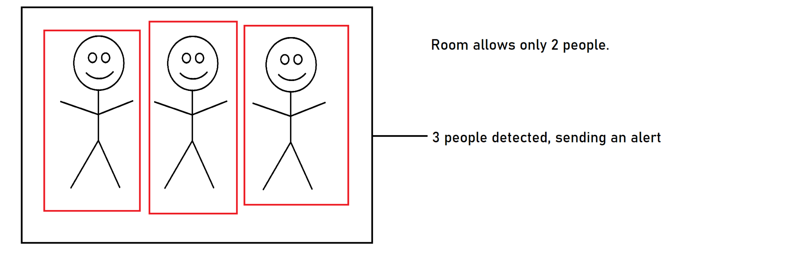
Innovations

Slide 4
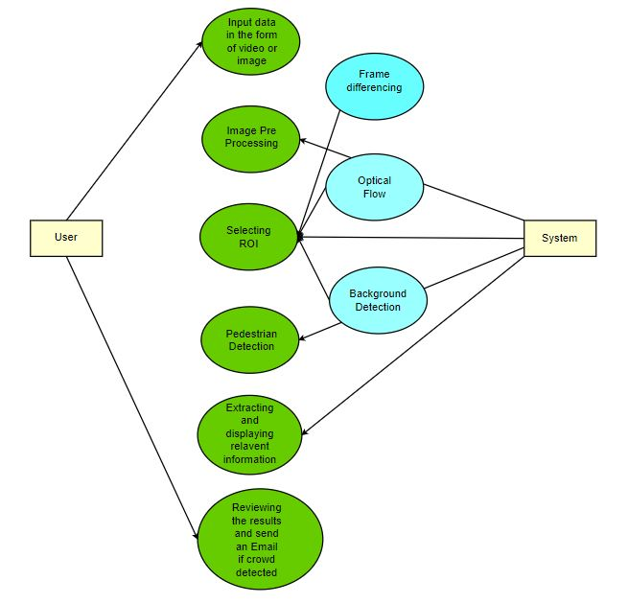
Use Case Diagram

Slide 5
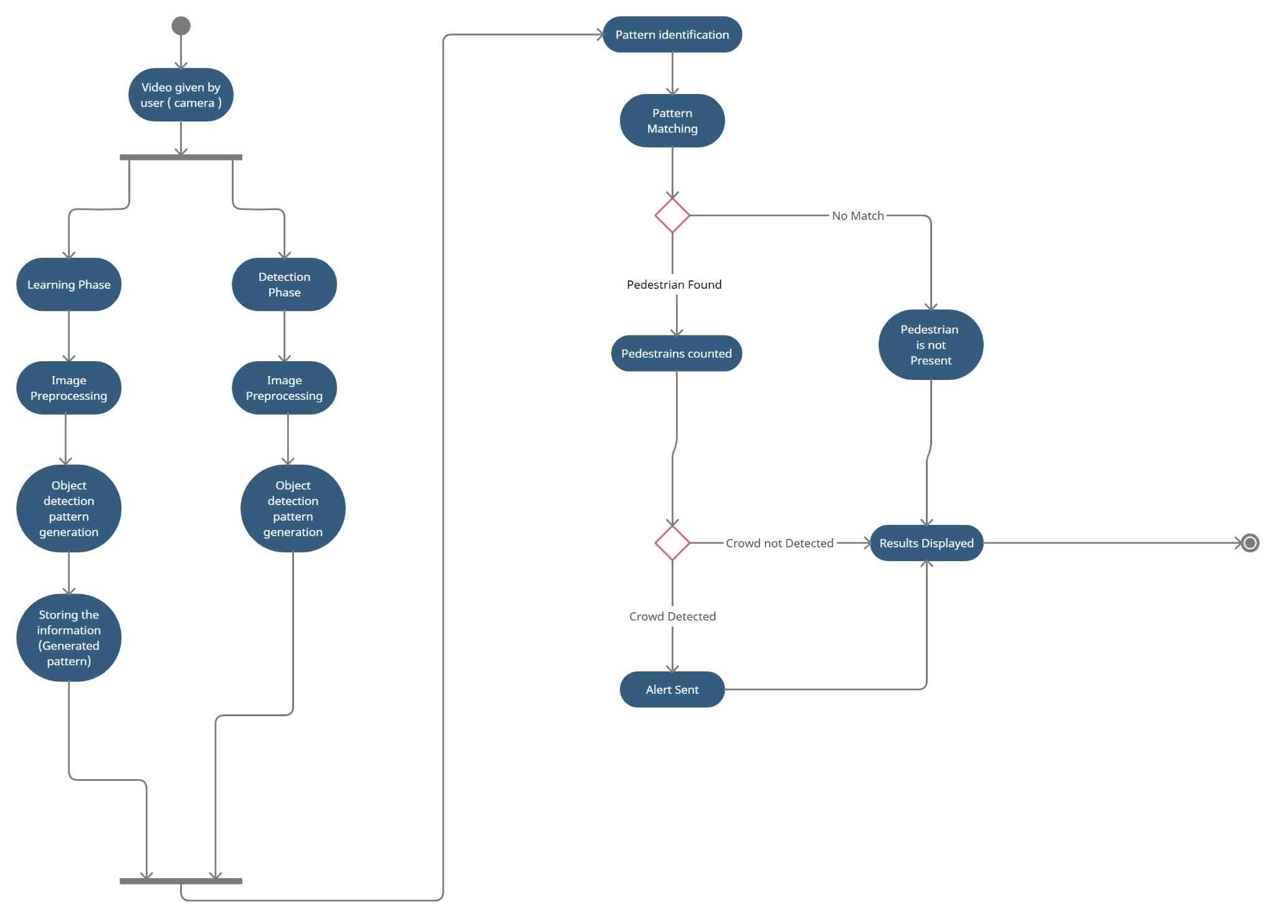
Activity Diagram

Slide 6
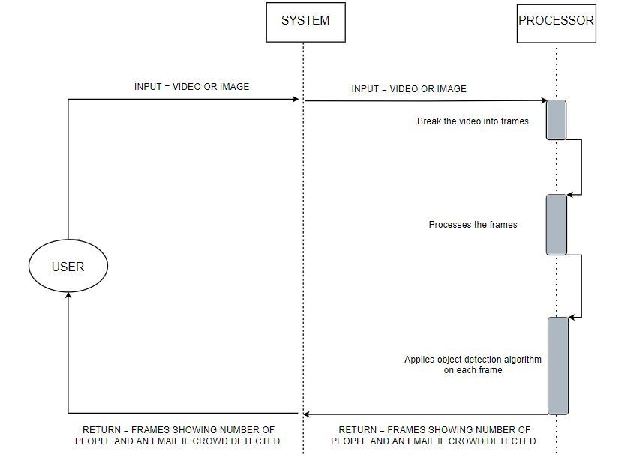
Sequence Diagram

Slide 7
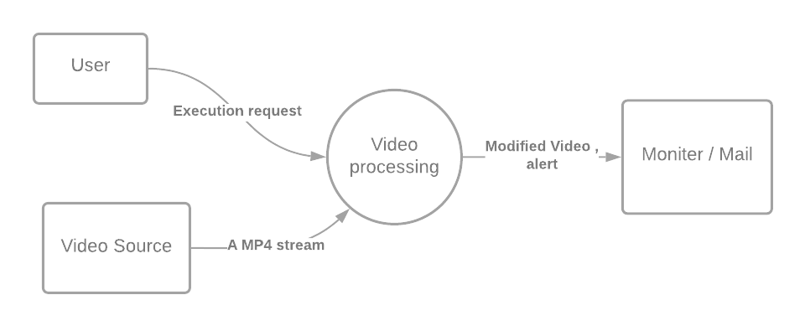
Data Flow Diagram
Level 0

Slide 8
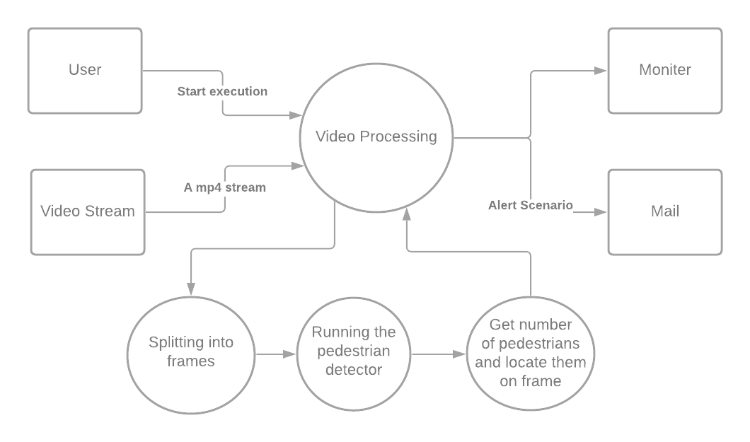
Data Flow Diagram
Level 1

